Slide 1
Re-study or re-reading creates
“Illusions of knowing”
Most common phrase uttered by students in introductory biology. “I really knew it but I don’t know what happened on the exam.”

Slide 2
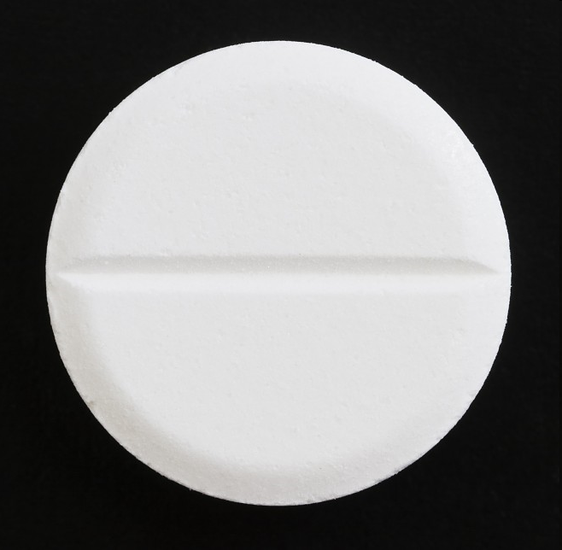
A prescription for becoming a successful biology student:
Biosmart
http://www.metacafe.com/watch/2696735/did_you_know/

Slide 3
Which labels go where?
Audio-visual
Demonstration
Discussion
Lecture
Practice
Reading
Teaching
Discuss with a partner.

Slide 4
teaching
practice
discussion
demonstration
audio-visual
reading
lecture
What do most students do when they study?

Slide 5
Reading is not studying!

Slide 6
Advice we’ll focus on tonight:
Build BOTH a deep foundation of factual knowledge AND strong conceptual framework.
Test yourself to determine what you don’t know.
Give yourself lots of opportunities to be wrong and embrace the mistakes and struggle as a necessary part of learning.
Study using methods that are better because cognitive science provides evidence that this is “better”.

Slide 7
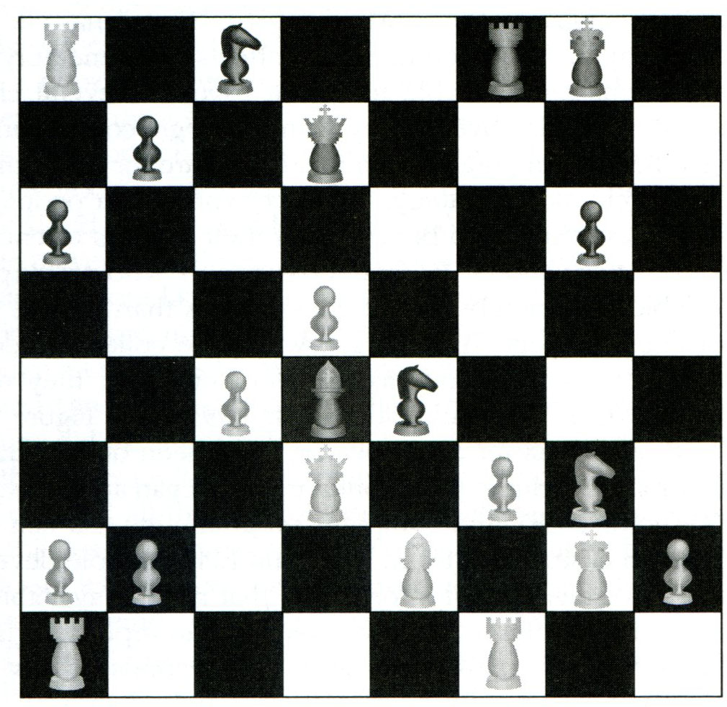
The value of conceptual frameworks
The chessboard challenge
How People Learn, Chase & Simon 1973

Slide 8
Correctly place the 25 chess pieces

Slide 9
Chess masters – Class A players – Beginners
Did everyone do better with each trial?
Who was the highest here?
Who was the highest here?

Slide 10
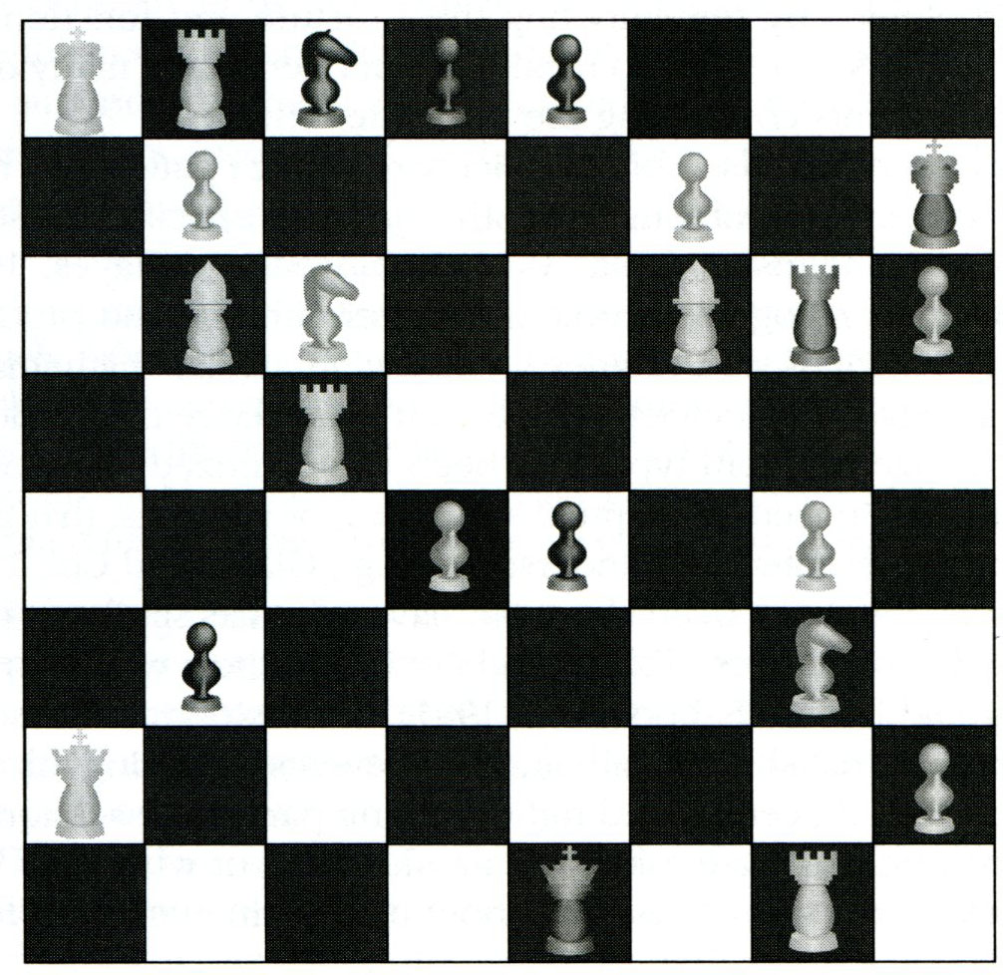
Board #2

Slide 11
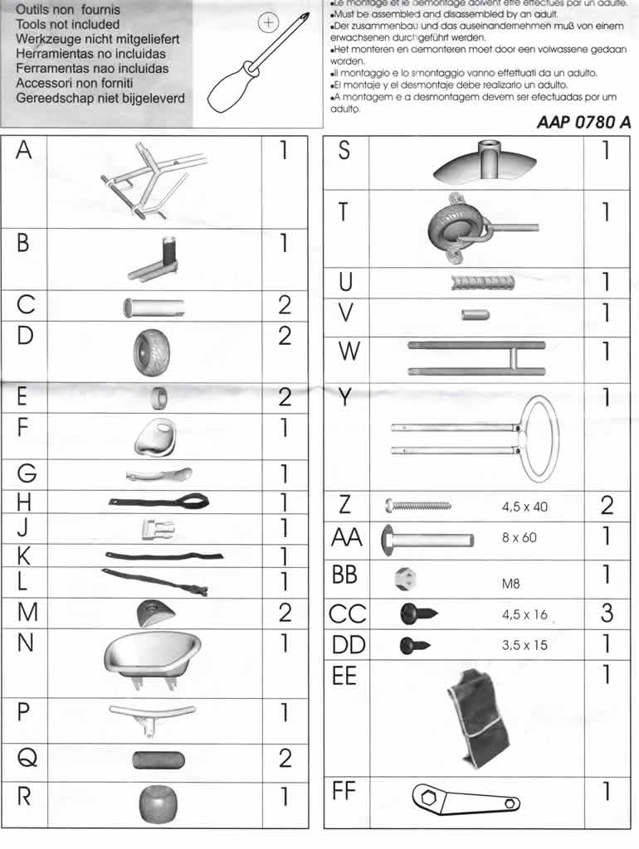

Slide 12
How is function of structure altered if cc breaks?

Slide 13
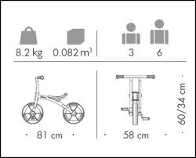

Slide 14
How do you build a framework?
Listen to an expert
Read a book written by an expert
These are passive ways to learn, but they help us initially build a framework.
Be careful about having the “illusion of knowing” because the lecture or book was well organized and you “understood it”
You need EVIDENCE of your understanding…

Slide 15
Use the Google Earth Method.
Start with the big picture, then zoom into more details.
Example: “Explain what the Meiosis is”
BIG PICTURE: Meiosis is how gametes form
MORE SPECIFIC: There are two divisions that result in four haploid gametes and each is infinitely unique because of metaphase I alignments and crossing over.
DETAILS: IPPMATPPMAT (explain or draw each stage)

Slide 16
Concept connections
Compare and contrast
Ex: Compare/contrast Meiosis I and Meiosis II
Ex: Sister chromatids vs. homologs
Ex: Sexual vs. asexual reproduction
Concept maps: list all the words you can think of for a concept or chapter and connect them visually with connector words
Ex: substrate, product, enzyme, competitive inhibitor, allosteric inhibitor, heat, denaturation, protein, protein structure, co-enzyme, ATP, metabolism, tertiary structure

Slide 17
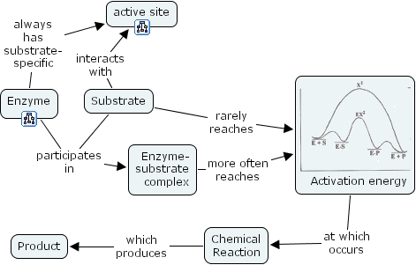
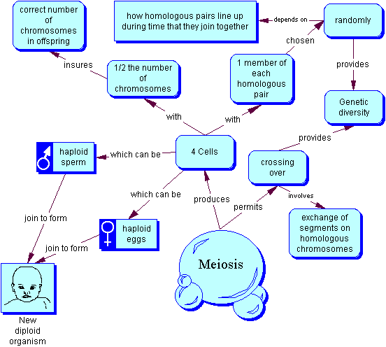
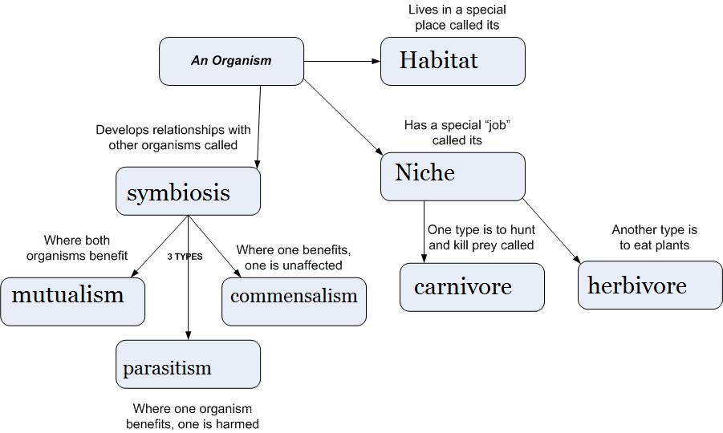
I grabbed all of these of Google in 2 minutes! Need ideas to get started? Look at examples.

Slide 18
Advice we’ll focus on tonight:
√
Build BOTH a deep foundation of factual knowledge AND strong conceptual framework.
Test yourself to determine what you don’t know.
Give yourself lots of opportunities to be wrong and embrace the mistakes and struggle as a necessary part of learning.
Study using methods that are better because cognitive science provides evidence that this is “better”.

Slide 19
How do you know when you know something?
Identifying what you DON’T know is the hardest part of learning. Figuring out the answers is often the easier part.

Slide 20
Useful studying always starts with blank paper and just your brain.
Where you get stuck on is what you need to go back to the book or another resource to re-learn

Slide 21
Post- class summary: 10 minutes
Summarize what you learned in class today on a blank piece of paper.
Don’t simply list topics I could find on a syllabus, summarize what YOU learned and what you want to know more about.
Think: Did you get any poll questions wrong that you learned from? Did you have a conversation with your group in which you were “fuzzy” on something?
Take out a piece of paper and do this now for a class you had today.
(5 min)
Keep track of any moments in class or on homework when you feel “fuzzy”. Find out more!

Slide 22
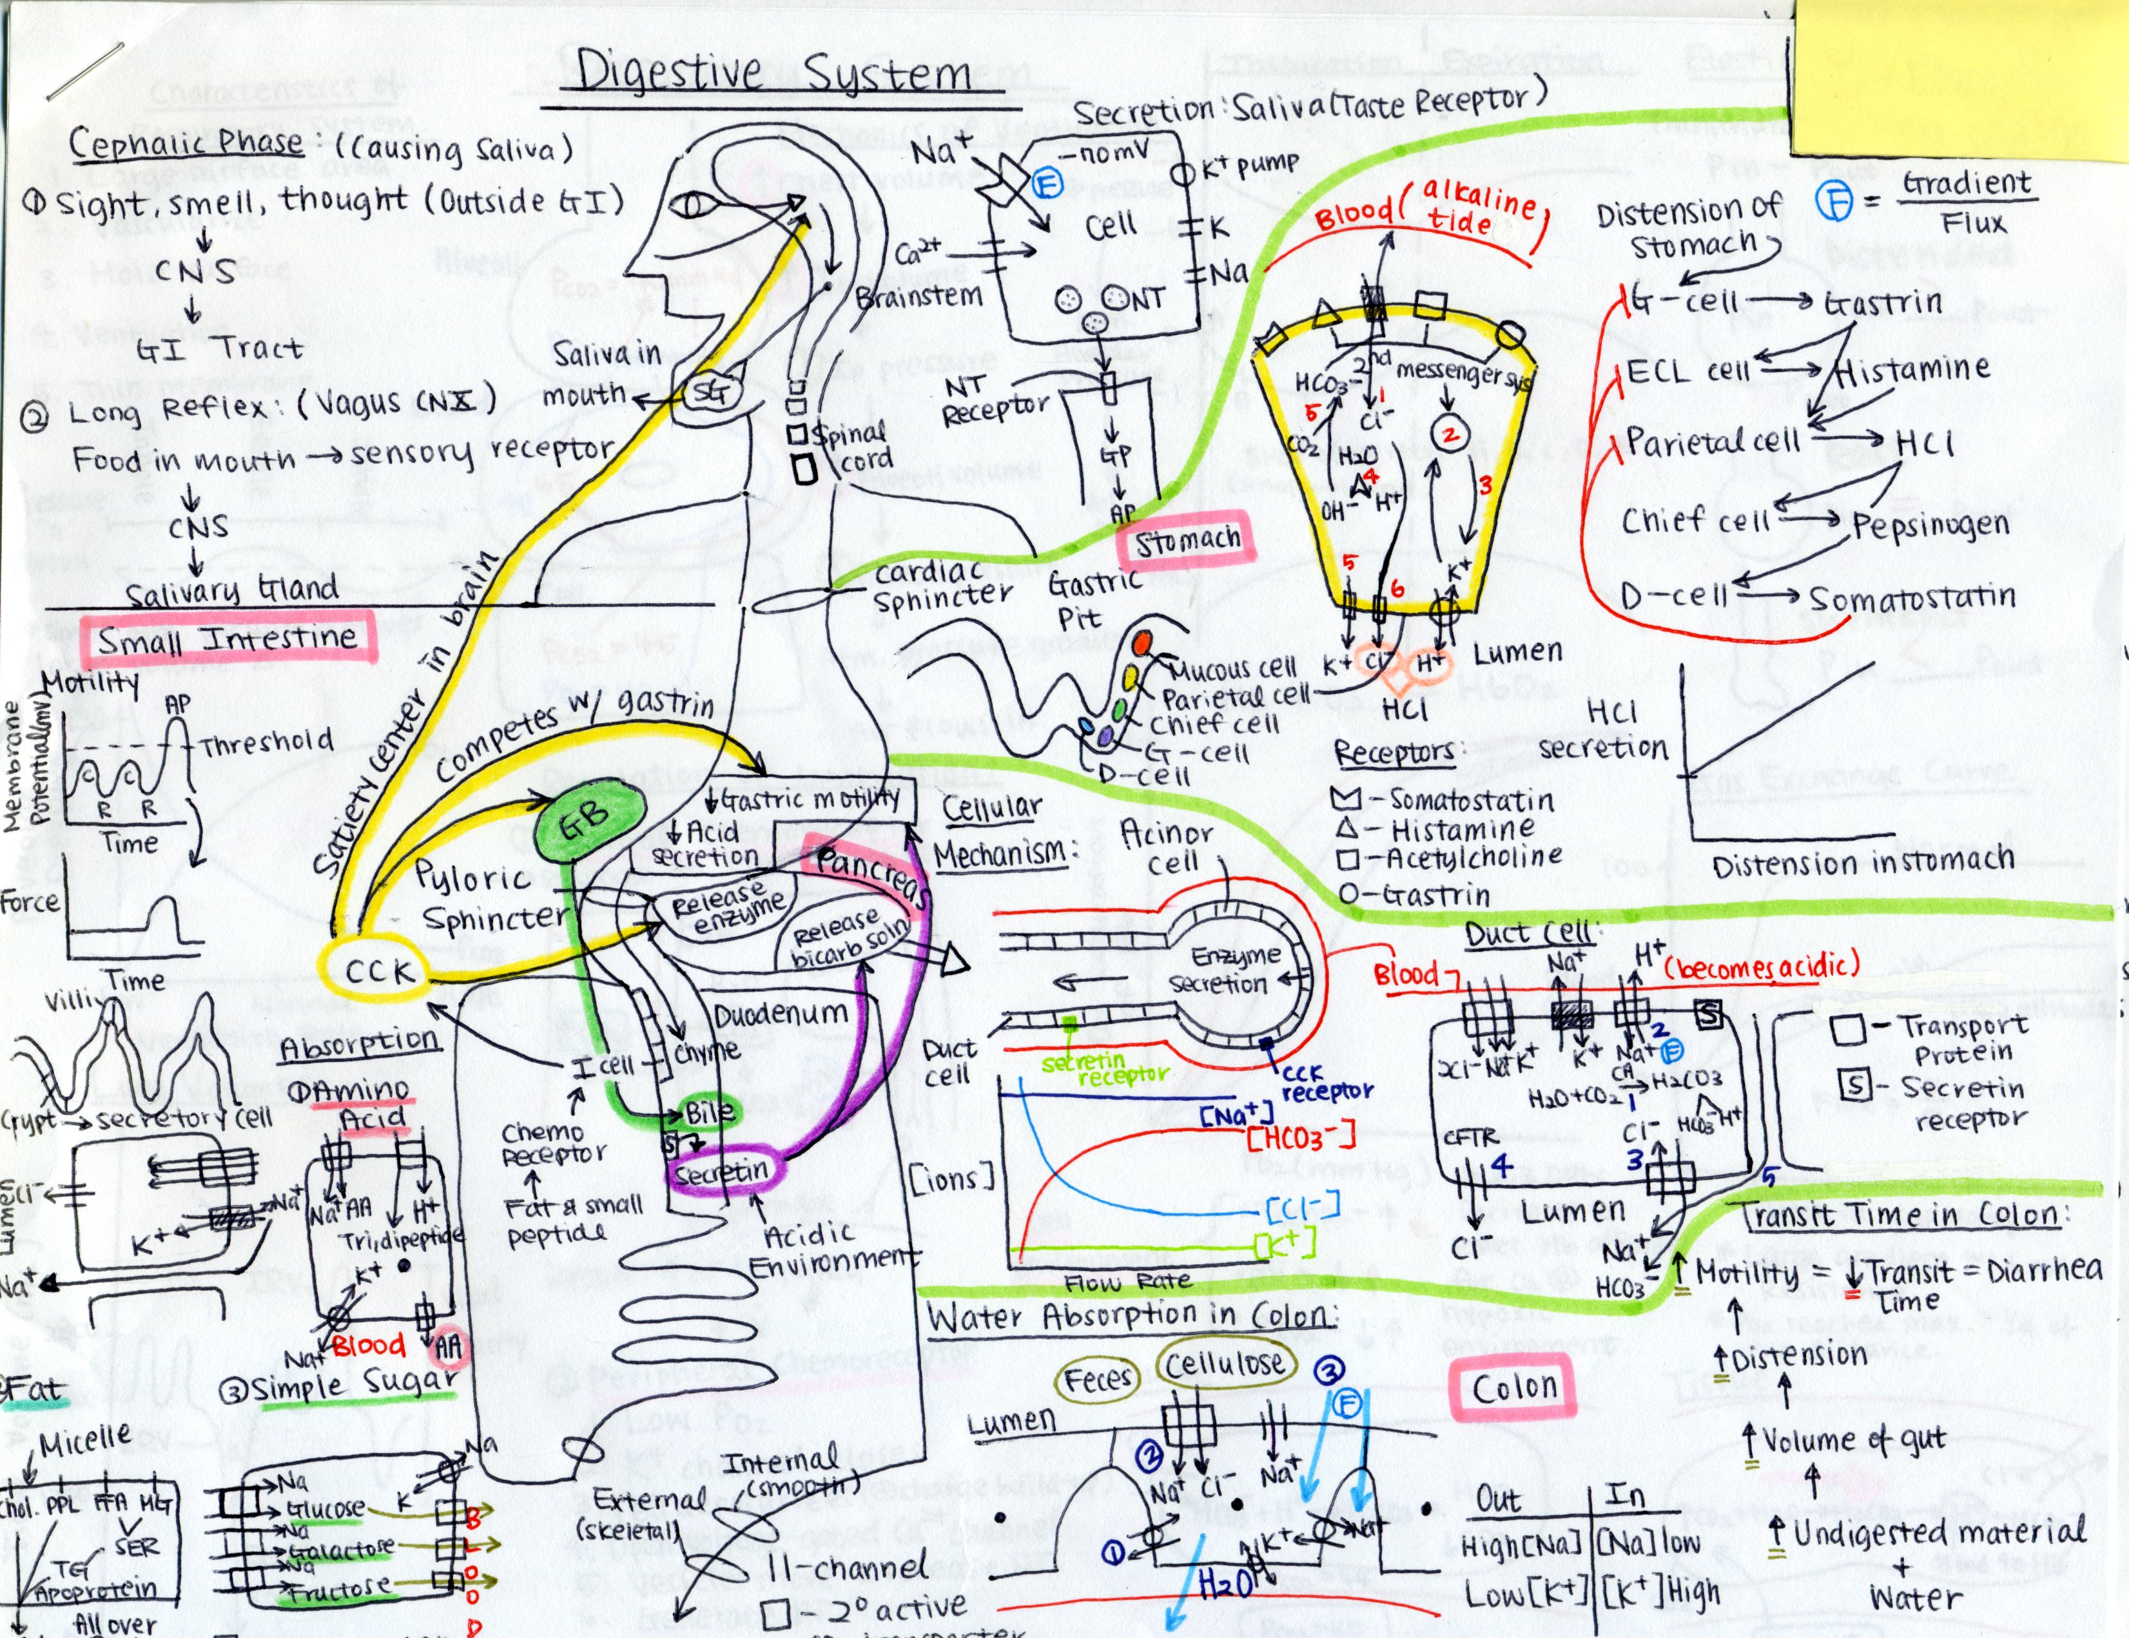
Summaries can be visual

Slide 23
Describe a mistake you recently made in life and one thing you learned from it.
You may respond at PollEv.com/khogan Or Text 805887 and your message to 37607
Example: “805887 I thought I told my husband about a meeting I had, but apparently did not. I learned we needed a shared online calendar.”
http://www.polleverywhere.com/free_text_polls/h0kHDt4ocpZLz4J

Slide 24
“I learned that I couldn’t draw metaphase I in class today and that I need to spend more time on this concept.”
“I got a question wrong on Mastering about the number of chromosomes in a gamete. I learned that I didn’t really understand the term haploid.”

Slide 25
Give yourself plenty of opportunities to be wrong. Make mistakes. Get stuck. Make it difficult.
We learn so much from being wrong.

Slide 26
A lot.
Test yourself
This provides the evidence you need that you are learning and points out the “holes” in your understanding.
Did your practice exam score clue you in that you might have some “holes?
Did the questions you needed to check before submitting on Mastering find some “holes”?
Did sitting in class and doing poll Qs or discussions find some “holes”?

Slide 27
Advice we’ll focus on tonight:
√
Build BOTH a deep foundation of factual knowledge AND strong conceptual framework.
Test yourself to determine what you don’t know.
Give yourself lots of opportunities to be wrong and embrace the mistakes and struggle as a necessary part of learning.
Study using methods that are better because cognitive science provides evidence that this is “better”.
√
√

Slide 28
First-year Physics sequence
Section A
Section B
Week
1
2
3
4
…
11
12
13
Instructor A
Instructor B
New instructor
Expert lecturer
Verify students are academically equivalent
TEST on Electromagnetism
12 MCQ- both instructors selected
Deslauriers, Schelew & Wieman Science 2011

Slide 29
New Instructor section of Physics
Pre-class reading assignment
Pre-class quiz ( short T/F)
Clicker question #1 2min
Instructor feedback 4min
Clicker question #2 2 min
Instructor feedback 4 min
Clicker question #2 2 min
Instructor feedback 5 min
Revote Clicker Q#2 1 min
Clicker questions#3 3 min
Instructor feedback 6 min
Group Task #1 6 min
Instructor feedback 4 min
Group Task #1 4 min
Instructor feedback 1 min
Instructor = 25 min
Students = 25 min

Slide 30
Outcome on a 12-question exam that both sets of students took??
Students with expert, experienced teacher did better
Hold up a fist at chest level if you think this
Students with inexperienced instructor did better
Hold up one finger at chest level (preferably not the middle finger) if you think this

Slide 31
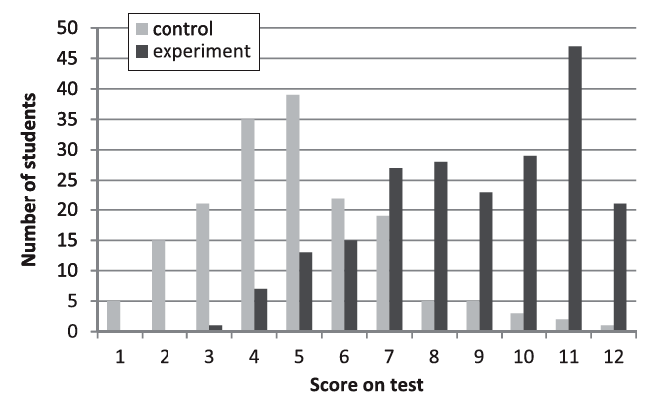
TEST on Electromagnetism
12 MCQ- both instructors selected
(Experienced instructor)
(New instructor)
Deslauriers, Schelew & Wieman Science 2011

Slide 32
Cognitive Science of Learning
12 word pairs Swahili-- English
Which group did best on second test?
1st
Which group did best on first test?
2nd
Group 1 S S S S Test -week - Test
Group 2 S S S T Test -week- Test
Group 3 S S T T Test -week- Test
Group 4 S T T T Test -week- Test
“Testing Effect”-- Retrieval

Slide 33
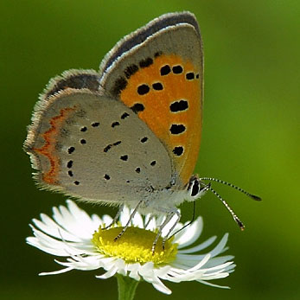
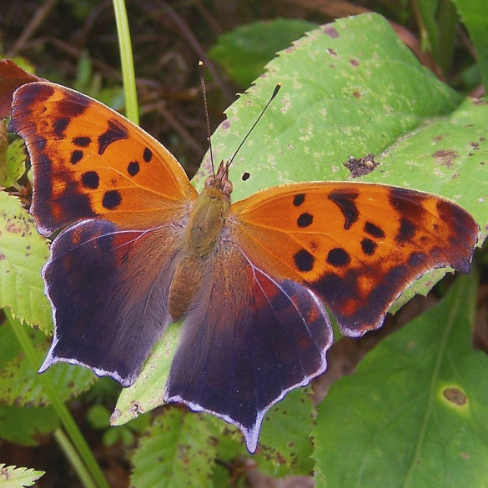
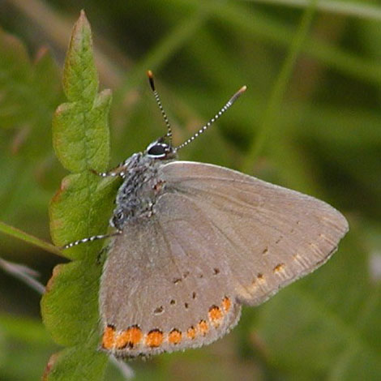
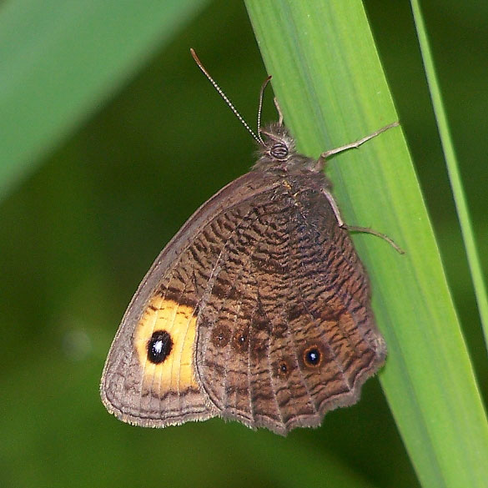
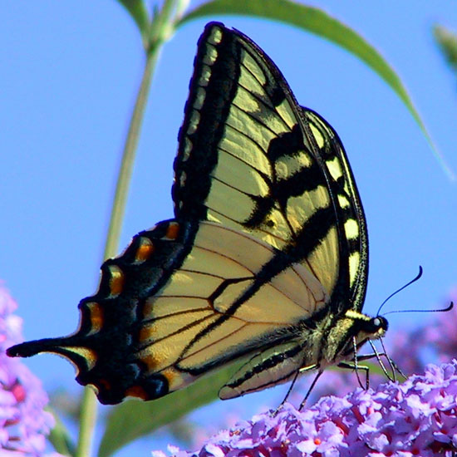
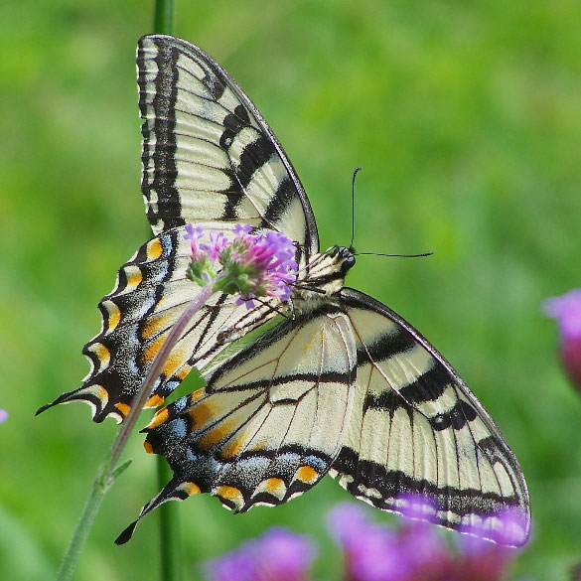
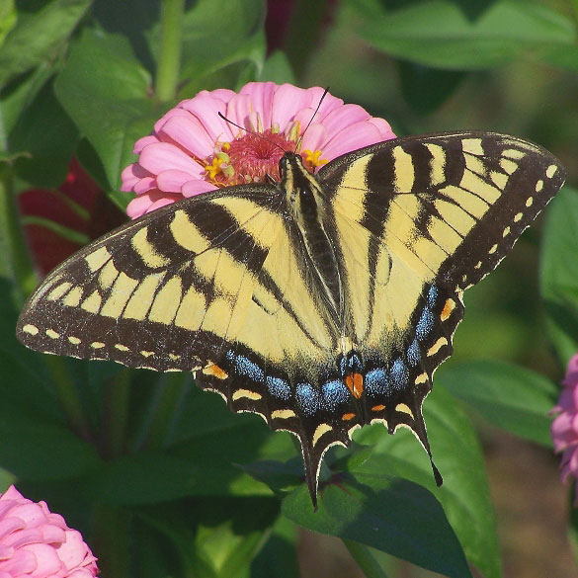
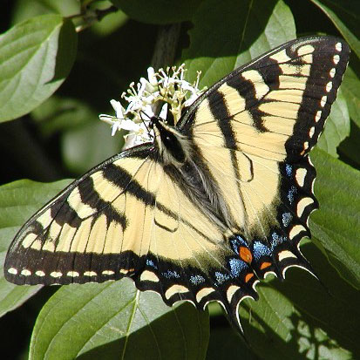
Does choosing the order of topics to study matter?
16 different types of butterflies
…
…
Copper
Mark
Streak
Nymph
Tiger
Tiger
Tiger
Tiger
Interleaved OR Blocked
Birnbaum, Kornell, Bjork, & Bjork (2009)

Slide 34
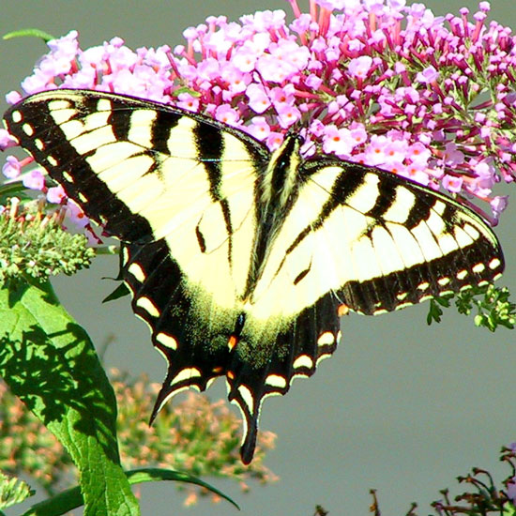
Please identify the image. Which of the following is it?
Admiral
American
Baltimore
Cooper
Eastern Tiger
Hairstreak
Harvester
Mark
Painted Lady
Pine Elfin
Pipevine
Spright
Tipper
Tree Satyr
Viceroy
Wood Nymph.
Did students that studied with interleaving or blocking do better?
http://www.polleverywhere.com/multiple_choice_polls/Ga82aAOnI3nTIqF
Birnbaum, Kornell, Bjork, & Bjork (2009)

Slide 35
Student’s Perception- What worked best?
Actual results
38
19
Birnbaum, Kornell, Bjork, & Bjork (2009)

Slide 36
It is not the number of times we listen or read information that helps us learn, it is the number of times we attempt to retrieve it.
Listening & Reading
Explaining
Drawing
Comparing Contrasting
Teaching
Acting/Modeling
Need ideas?
See next few slides.

Slide 37
Recall information (Don’t spend all your time here!) | Who, what, when, where Define/Name…. List the components…
Explain Ideas or Concepts | Draw an image that comes to mind… How would you illustrate, outline, diagram…. Write in own words/Explain to neighbor… Explain what this figure is showing. What is the most unclear point from the unit/today’s session? Google Earth method: Big idea→ a more specific statement → details Draw a graph that depicts….. Summarize what you learned today. Why is this topic important? Can you make paper cut-outs and move them around?

Slide 38
Comparing to something familiar | Explain why this topic could be linked to something relevant to your daily life. Come up with a metaphor or analogy for this structure/process , etc. ____ is the same as ______ Think of a way to model the concept with everyday objects. Pretend you need to explain it to an 8 year old. You can’t use fancy terminology—you must use familiar words and convey meaning and importance.
Connecting to another topic | How does this connect with other topics we have explored/you know about? How is this similar or different to _______? What does this remind you of? Compare/ Contrast Pick terms/concepts and draw a concept map to connect them Randomly find words on book pages and try to connect them in sentences.

Slide 39
Design Questions | Write multiple choice questions that you think assess understanding and not simply memorization. Have a friend do them. Take a good multiple choice question and see if you can write three more based on that one. (Anticipate what I might ask.) Write a T/F quiz for a friend. Spend time discussing answers. The ones you argue about are the good ones!
Justify your answers or Evaluate someone else | Take multiple choice questions from class, homework, Google, etc. and explain why the right answer is right. Explain why the wrong answer is wrong. Let your friend explain a process or draw a concept. Evaluate your friend’s answer.

Slide 40
Re-study or re-reading creates
“Illusions of knowing”
Most common phrase uttered by students in introductory biology. “I really knew it but I don’t know what happened on the exam.”

Slide 41
Advice we focused on tonight:
Build BOTH a deep foundation of factual knowledge AND strong conceptual framework.
Test yourself to determine what you don’t know.
Give yourself lots of opportunities to be wrong and embrace the mistakes and struggle as a necessary part of learning.
Study using methods that are better because cognitive science provides evidence that this is “better”.

